Slide 1
Applied Data Science with Python
Notes:
Let's understand how to apply data science with Python.

Slide 2
Introduction to Data Science
Notes:
This lesson will introduce you to Data Science.

Slide 3

Explain the basics of data science and its application to derive meaningful insights
List the steps of the data science process to solve problems systematically
Explore the Python packages for data science to efficiently perform data analysis, data manipulation, and data visualization
Describe the types of plots available for visualization to communicate data insights and trends effectively
Notes:
Instructor Notes:
Read the learning objectives

Slide 4
Introduction

Slide 5

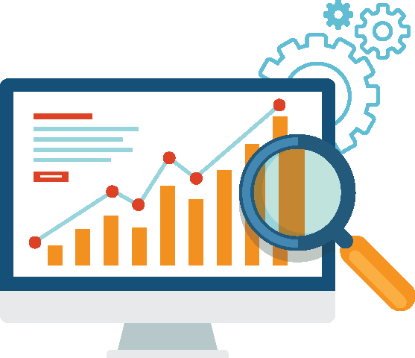
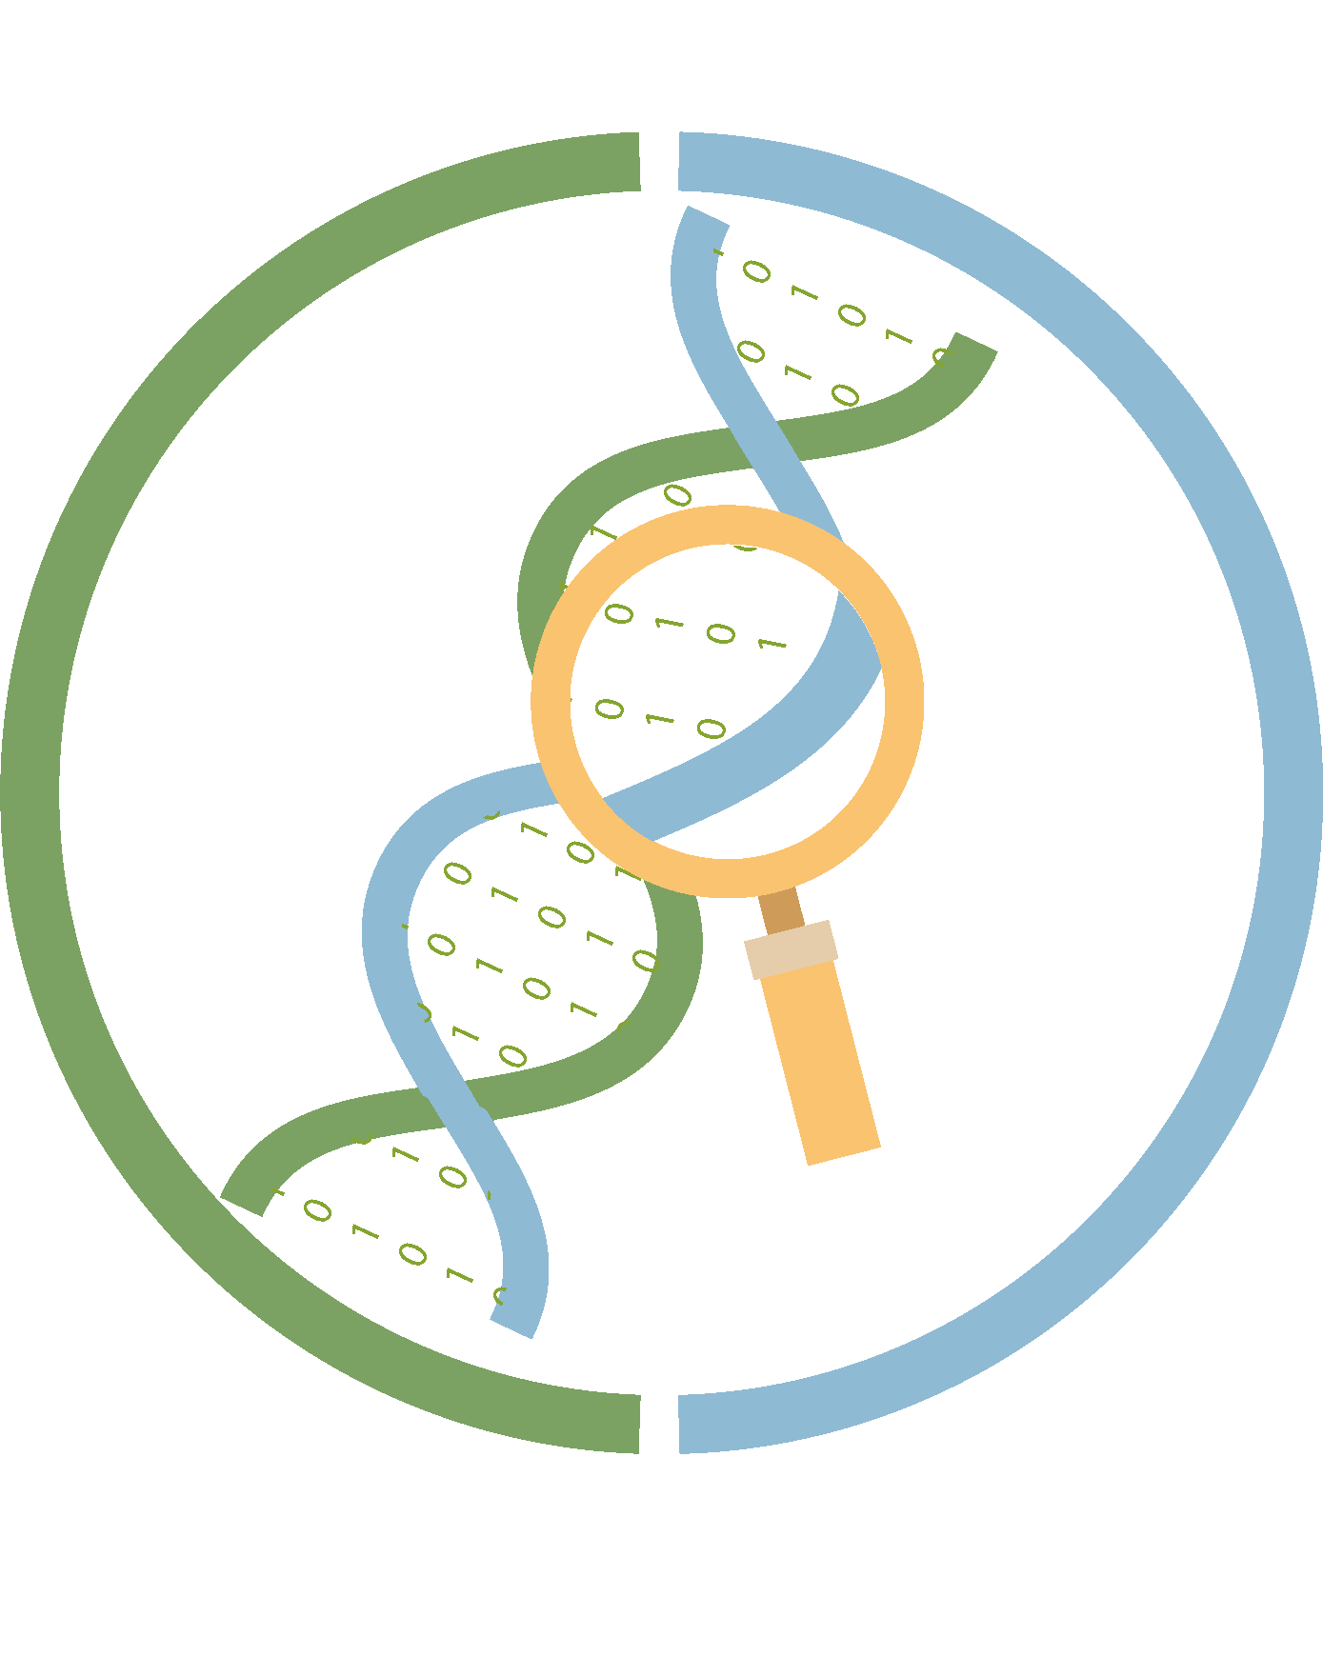
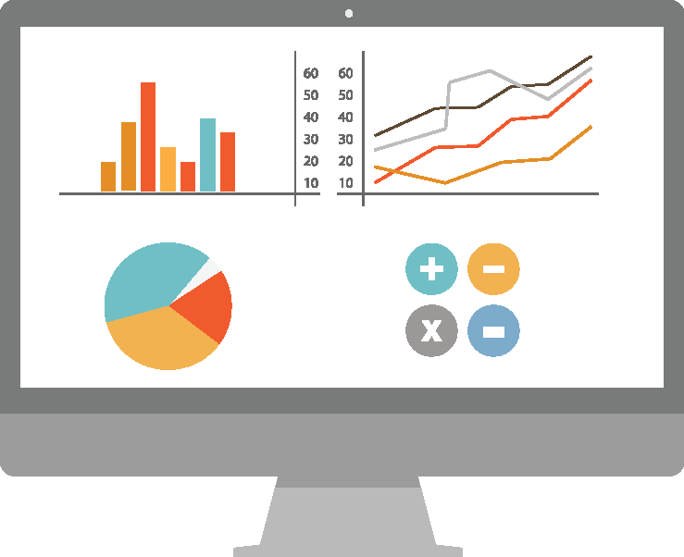
Data Science
Data science is a multidisciplinary field that uses scientific methods, processes, algorithms, and systems to derive meaningful insights from structured and unstructured data.
Example
Using a search engine or making a purchase on Amazon provides valuable data to data science-driven software systems operating
in the background.
Data on interactions with online platforms is gathered to understand user preferences and suggest search results or items to buy.
Notes:
Instructor Notes:
It combines various aspects of statistics, mathematics, computer science, and domain expertise to uncover patterns, trends, and valuable information from vast and complex datasets.

Slide 6




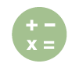


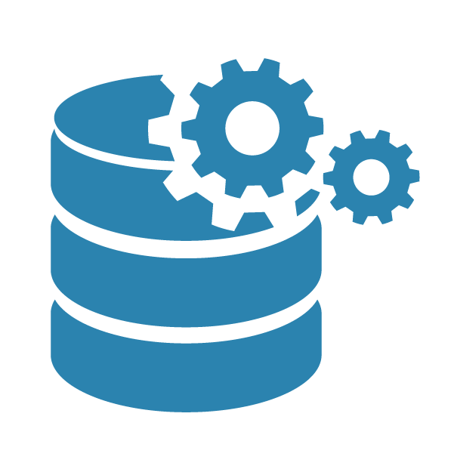


Data Science
Data science emerges from the combination of subject expertise, scientific methodologies, and technology.
Domain expertise and scientific methods
Technology
Operating systems
Analysis
Mathematical and statistical models
Scientific
tools and methods
Python
language
Application
design
Data science
Data processing tools
Library
Notes:
Instructor Notes:
This slide is self-explanatory.

Slide 7


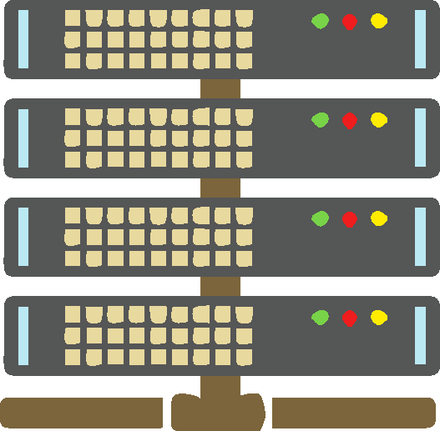

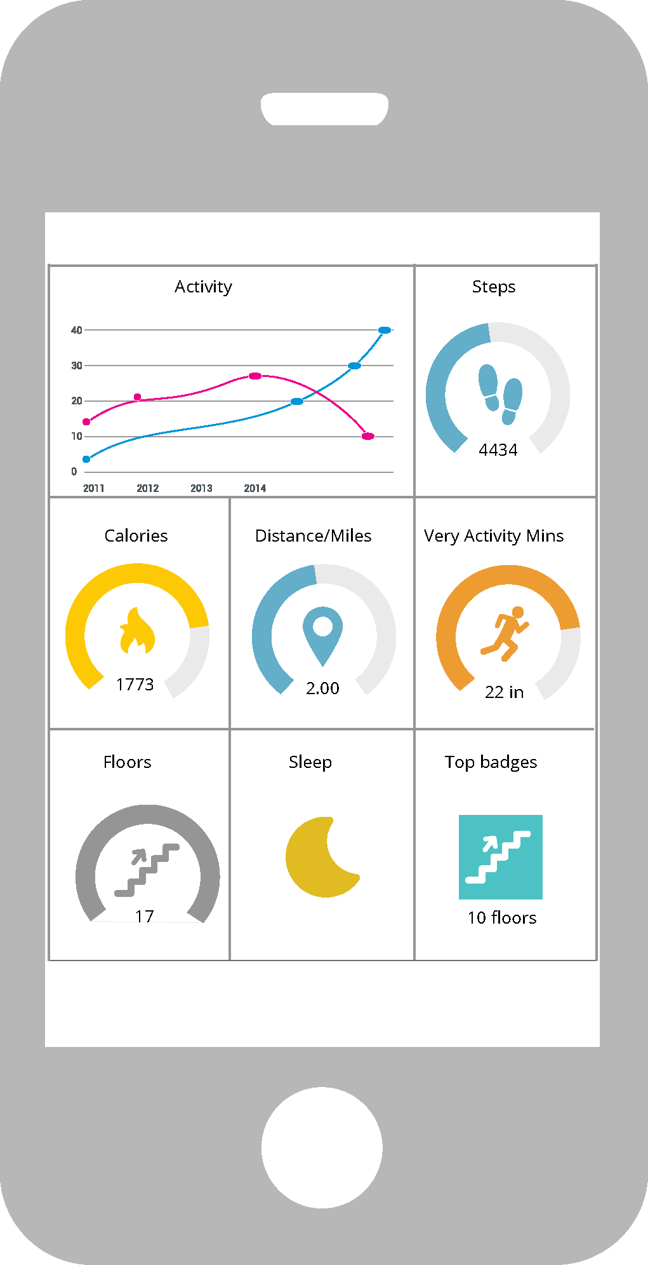

Application of Data Science: Healthcare
Wearable devices use data science to analyze data from their biometric sensors.
Biometric data transfer
IoT gateway
Data transfer to servers
Enterprise infrastructure
Wearable device
Informed decision-making
Engagement dashboard
Data analytics
Notes:
Instructor Notes:
Explain data science application related to healthcare.

Slide 8
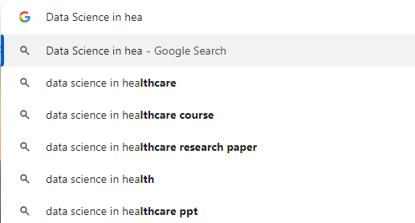
Application of Data Science: Search Engines
Google employs data science to offer relevant search recommendations as users type in their queries.
Search keyword
Fast and real-time analytics is made possible by modern and advanced infrastructure, tools, and technologies.
Notes:
Instructor Notes:
Explain data science application related to search engines.

Slide 9










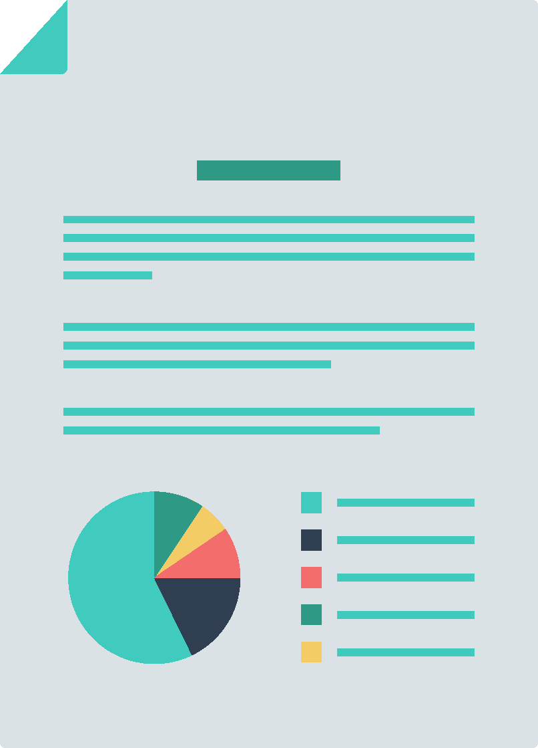


Application of Data Science: Finance
Using data science, a loan manager can easily access and sift through an applicant's financial details.
Data transfer to servers
Enterprise infrastructure
Loan application portal
Loan applicant
Credit report, credit history, approved amount, and risk
Engagement dashboard
Make informed decisions
Data analytics
Notes:
Instructor Notes:
Explain data science application related to finance.

Slide 10
Data Science Process

Slide 11
Data Science Process
Data collection
Feature
engineering
Model evaluation
1
2
3
4
5
6
7
Problem definition
Data cleaning and exploration
Model building and training
Model
deployment
Notes:
Instructor Notes:
Here's a breakdown of the data science process: 1. Define the problem you aim to solve. 2. Collect relevant data sources for analysis. 3. Clean and explore the collected data to understand its structure and quality. 4. Create or transform features (characteristics) to improve the predictive accuracy of the data. 5. Build and train models using the prepared data. 6. Evaluate model performance to assess its effectiveness and generalization. 7. Deploy the finalized model for practical use or further testing in real-world scenarios.

Slide 12
Data Science Process
Problem definition:
Clearly define the goal or question to be addressed through data analysis, forming the foundation for subsequent steps.
Data collection:
Gather relevant datasets or information sources necessary to address the defined problem.
Data cleaning and exploration:
Preprocess the data by handling missing values, outliers, and other inconsistencies, and explore the dataset to gain insights and identify patterns.
Notes:
Instructor Notes:
This slide is self-explanatory.

Slide 13
Data Science Process
Feature engineering:
Create or transform new features to enhance the dataset's information and improve model performance.
Model building and training:
Develop a predictive or descriptive model using machine learning algorithms and train it on the prepared dataset.
Model evaluation and deployment:
Evaluate, optimize, and fine-tune the model for peak performance, then deploy it into a production environment for real-world use.
Notes:
Instructor Notes:
This slide is self-explanatory.

Slide 14
Python for Data Science

Slide 15

Python for Data Science
Python is the preferred programming language for data science projects across industries.
It has multiple open-source packages like NumPy and Pandas for data cleaning, exploration, and visualization.
Notes:
Instructor Notes:
There are many reasons why Python is the preferred programming language for data science projects across industries. Python has multiple open-source packages like NumPy and Pandas to perform data cleaning, data exploration, and data visualization

Slide 16

Advantages of Using Python for Data Science
Open-source, interpreted, high-level language that supports object-oriented programming
Ease of use and simple syntax
Scalability when compared to R
Availability of a wide variety of data science libraries and packages
Compatibility with all major operating systems
Creation of new data science libraries daily by a vast number of online user communities
Powerful visualization libraries
Notes:
Instructor Notes:
Discuss the advantages of using Python for data science

Slide 17
Python Packages for Data Science

Slide 18

Numpy
NumPy is a Python library for scientific computing that supports large multi-dimensional arrays and matrices and includes a comprehensive mathematical library.
Use NumPy to perform complex mathematical operations on large datasets, such as linear algebra calculations, statistical analysis, and Fourier transform.
Financial analysts use NumPy for quantitative analysis, such as calculating the mean return and volatility of stocks to inform investment decisions.
Notes:
Instructor Notes:
NumPy which is the abbreviation for Numerical Python is an open-source library predominantly used for working with arrays. It enables most of the operations required in linear algebra. As NumPy works with arrays instead of traditional Python lists, it is computationally efficient. In data science, we often use arrays to take advantage of this computational efficiency. NumPy is used alongside SciPy and Matplotlib. This combination replaces Matlab, which has been the traditional standard for technical computation.

Slide 19

Pandas
Pandas is a library for efficient storage and manipulation of structured data, such as
time series and tables.
E-commerce companies use Pandas to analyze customer purchase history to recommend products and personalize shopping experiences.
Researchers use Pandas to manage and analyze large datasets of health records to identify trends in disease outbreaks.
Notes:
Instructor Notes:
Pandas is an open-source library built on top of NumPy. Thus, several NumPy structures are used or replicated in Pandas. The word Pandas is derived from panel data, a term from econometrics. Pandas allows us to work with structured datasets, such as tabular, time series, and matrix.

Slide 20

SciPy
SciPy (Scientific Python) is an open-source library built on top of NumPy and is used for implementing scientific formulas like PV=nRT and V=IR.
It is tailored for scientific and engineering applications such as weather forecasting and
drug discovery.
Engineers use SciPy to solve complex mathematical problems in structural engineering, such as stress and strain analysis in materials.
Notes:
Instructor Notes:
SciPy, which is the abbreviation for Scientific Python is an open-source library built on top of NumPy. It is tailored for science and engineering applications.

Slide 21
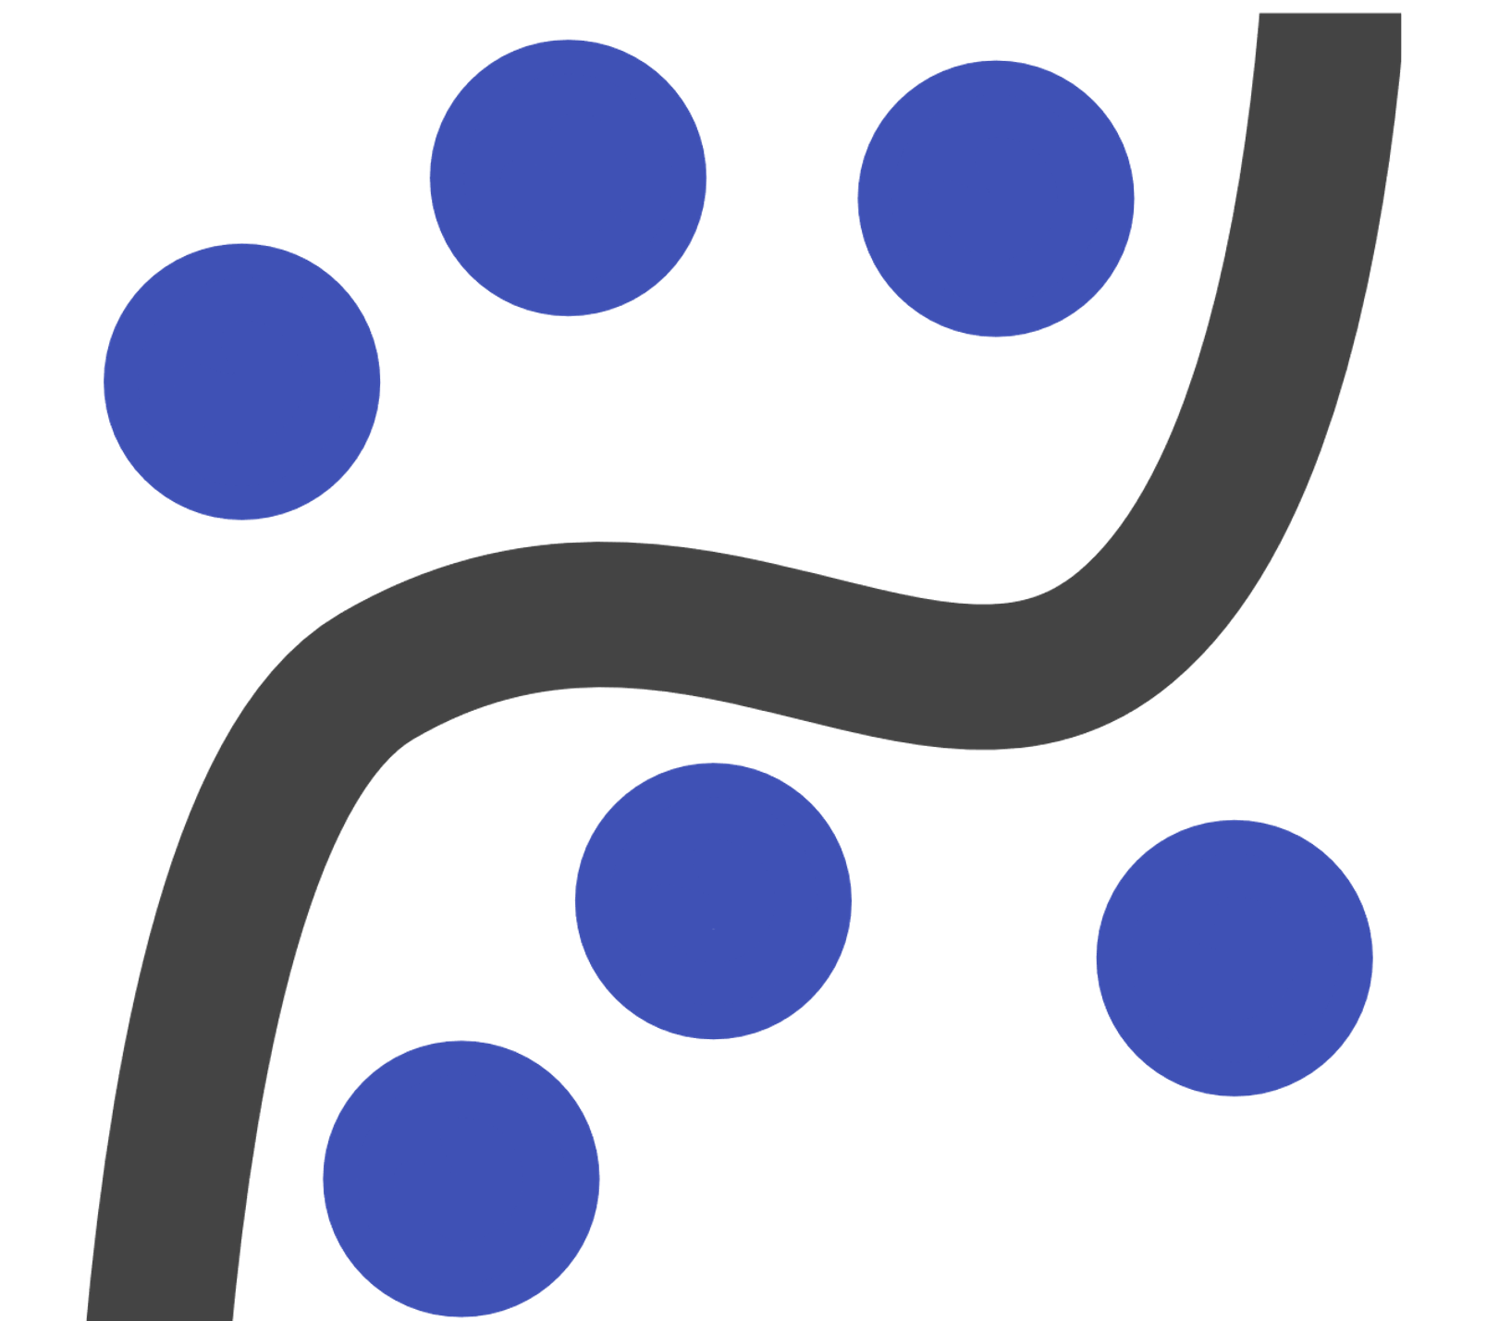
Statsmodels
Statsmodels is a Python module that provides classes and functions for estimating many different statistical models and conducting statistical data exploration.
Market researchers use Statsmodels to perform regression analysis to understand how different factors, such as advertising spend, affect sales.
Policy analysts use Statsmodels to evaluate the impact of public policies on social and economic outcomes through statistical testing and analysis.
Notes:
Instructor Notes:
Statsmodels is a crucial python library that allows the estimation of statistical models and perform statistical tests. It includes an extensive list of descriptive statistics, statistical tests, plotting functions, and result statistics for different types of data. Stats models can handle a deep statistical research project.

Slide 22



Scikit-Learn
Scikit-learn is a widely-used open-source machine learning library for Python, known for its simplicity, ease of use, and versatility in handling various machine learning tasks.
It analyzes customer reviews for sentiment classification in marketing and social
media analysis.
It identifies objects in images for autonomous vehicles and facial recognition systems.
It detects fraudulent transactions in banking and
e-commerce platforms.
Notes:
Instructor Notes:
This slide is self-explanatory.

Slide 23

Matplotlib
Matplotlib library is a comprehensive tool for building static, animated, and interactive visualizations, including line plots, scatter plots, bar charts, histograms, pie charts, and more.
Matplotlib is an open-source library and can be used freely.
Notes:
Instructor Notes:
Explain the matplotlib briefly.

Slide 24

Seaborn
Seaborn is a data visualization library in Python that is built on top of Matplotlib.
It provides a high-level interface for creating attractive and informative statistical graphics, like histograms, box plots, violin plots, heatmaps, and error bars.
It simplifies the process of creating aesthetically pleasing and informative plots, especially for statistical and categorical data.
Notes:
Instructor Notes:
Explain the seaborn library briefly.

Slide 25

Plotly
Plotly is a Python library for creating interactive, publication-quality graphs and visualizations. It is suitable for web-based applications.
It enables Python users to create interactive and customizable visualizations for data analysis.
It supports various plot types, such as line plots, scatter plots, and histograms, which enhance data exploration.
Notes:
Instructor Notes:
Explain the plotly library briefly.

Slide 26
Types of Plots with Examples

Slide 27
Types of Plots: Line Plot
A line plot displays data points connected by straight lines, often used to visualize trends or relationships between two variables over time or other continuous intervals.
10
A line chart visualizes stock prices over time, tracking trends and making investment decisions based on historical data.
It displays temperature variations throughout the year to analyze seasonal patterns and plan agricultural activities effectively.
8
6
4
2
0.0
0.5
1.0
1.5
2.0
2.5
3.0
Notes:
Instructor Notes:
This slide is self-explanatory.

Slide 28
Types of Plots: Marker Plots
A marker plot displays data points with markers, useful for scatter plots and visualizing individual data observations.
10
A marker plot is used to display individual data points on a map, such as marking specific locations for a survey.
It is employed to plot stock prices over time, with markers indicating specific events like buy or sell signals.
8
6
4
2
0.0
0.5
1.0
1.5
2.0
2.5
3.0
Notes:
Instructor Notes:
This slide is self-explanatory.

Slide 29
Types of Plots: Scatter Plots
The scatter plot is a collection of points plotted on two axes, horizontal and vertical.
The scatter plot analyzes relationships between two variables, like comparing height and weight in a population.
It helps visualize data clusters, such as grouping students based on exam scores.
7
6
5
4
3
3
4
5
6
7
Notes:
Instructor Notes:
This slide is self-explanatory.

Slide 30
Types of Plots: Area Plots
An area plot represents data with shaded areas useful for showing cumulative totals or proportions
over time.
An area plot visualizes cumulative data changes over time, such as tracking total sales revenue over successive quarters.
It illustrates the distribution of different categories' contributions to a whole, like displaying market share evolution.
25
A
B
C
20
15
10
5
0
1.0
1.5
2.0
2.5
3.0
3.5
4.0
4.5
5.0
Notes:
Instructor Notes:
This slide is self-explanatory.

Slide 31
Types of Plots: Bar Plots
Bar plots are rectangular graphs that show vertical and horizontal data comparisons based on another axis (usually the X-axis).
200
A bar plot compares sales of different products over a month.
It also displays student grades in different subjects.
175
150
125
100
75
50
25
0
1
2
3
4
5
Notes:
Instructor Notes:
This slide is self-explanatory.

Slide 32
Types of Plots: Grid Plots
Grid plots assist chart viewers in determining what value an unlabelled data point represents.
400
Grid plots enable side-by-side comparison of multiple plots, enhancing visual analysis.
They enhance presentation clarity by organizing complex information systematically.
350
300
250
200
150
100
1.0
1.5
2.0
2.5
3.0
3.5
4.0
Notes:
Instructor Notes:
This slide is self-explanatory.

Slide 33
Types of Plots: Histogram Chart
A histogram visually displays the distribution of a dataset by dividing values into bins and representing the frequency of each bin with bars.
Histograms visualize the distribution of numerical data, like income levels or exam scores.
They help make inferences about data characteristics and underlying patterns, guiding decision-making processes.
0.4
0.3
Probability
0.2
0.1
0.0
-3
-2
-1
-0
1
2
3
4
Data
Notes:
Instructor Notes:
This slide is self-explanatory.

Slide 34
Types of Plots: Pie Chart
Pie charts are circular graphs in which data are plotted within components or segments of the pie.
Java
Pie plots show the proportions of a whole, like market shares or survey responses.
They simplify complex data by representing it in an easily understandable format.
26.3%
Python
26.5%
30.7%
Ruby
16.3%
++
C
Note: Examples of these plots are provided in the Data Visualization lesson, accompanied by detailed explanations and Python code.
Notes:
Instructor Notes:
This slide is self-explanatory.

Slide 35
Data science involves the analysis and interpretation of data to generate actionable insights.
NumPy (Numerical Python) is an open-source library predominantly used when working with arrays.
Seaborn is a data visualization library in Python that is built on top of Matplotlib.
Python is the preferred programming language for data science projects across industries.
Notes:
Instructor Notes:
Read all the key takeaways.

Slide 37
Which stage in the data science process involves preparing the data for modeling by addressing missing values, outliers, and data formatting?
1
Data collection
Data cleaning and exploration
Model building and training
Model evaluation

Slide 38
Which stage in the data science process involves preparing the data for modeling by addressing missing values, outliers, and data formatting?
1
Data collection
Data cleaning and exploration
Model building and training
Model evaluation
B
Data cleaning and exploration involves preparing data for analysis by addressing missing values, outliers, and data format.

Slide 39
What is the purpose of data cleaning and preparation in the data science process?
2
To increase the size of the dataset
To decrease the accuracy of the model
To ensure greater accuracy while building the model
To reduce the amount of data required for the model

Slide 40
What is the purpose of data cleaning and preparation in the data science process?
2
To increase the size of the dataset
To decrease the accuracy of the model
To ensure greater accuracy while building the model
To reduce the amount of data required for the model
C
Data cleaning and preparation are important steps in the data science process to ensure greater accuracy while building the model.

Slide 41
What is another term for stack plots featuring dispersed areas indicating highs and lows?
3
Line plot
Scatter plot
Area plot
Box plot

Slide 42
What is another term for stack plots featuring dispersed areas indicating highs and lows?
3
Line plot
Scatter plot
Area plot
Box plot
C
Area plots, also known as stack plots, are dispersed throughout certain areas with bumps and drops (highs and lows).

Slide 43
Thank You

